Slide 1



Hold My Beer. We’re Going Scumban!
,
Presented by:
D. Mark Haynes – Scrum Master, Agile Coach
dmarkhaynesconsulting@godaddy.com
Providing IT Services for over 20 years for:
Project Management, Quality Assurance, Software Estimation & Process Improvements
Agile/Scrum, Rational Unified Process (RUP), & Waterfall methodologies
Logistics, Health-care, Insurance, Automotive, Telecommunications, Marketing & Financial applications

Slide 2









Cincy Deliver 2021 Sponsors
Diamond
Platinum
Gold

Slide 3
You are what you Do
Biologist
Software Developer
Quality Assurance Analyst
Project Leader Development
Project Leader Testing
QA Manager
Test Coordinator
Project Manager
Process Improvement Manager
Software Estimation Expert
Scrum Master
Coach - Mentor - Trainer
Speaker
Author
07/29/21
Notes:
I'm a renaissance man trapped in a specialist's body.
I started as a biologist and that's why I became an IT guy.
I was a software developer with an elegant language for a more civilized age.
I became a Quality Assurance Analyst because it's better to give than receive.
I became a Process Improvement specialist because it's easier to negotiate with a terrorist than a Methodologist.
I became a Scrum Master because there was this big line and they were serving free cool-aid.
Typical interview question. How long have I been agile? Answer. Always. I just didn't know what it was called before.

Slide 4

Who Me Worry?
Notes:
Full Disclosure - I don't like hybrids
Without guiding principles your actions will whipsaw back and forth, providing no clear direction
It creates indecision and implements the worst features of both
Hybrids are problematic at best

Slide 5
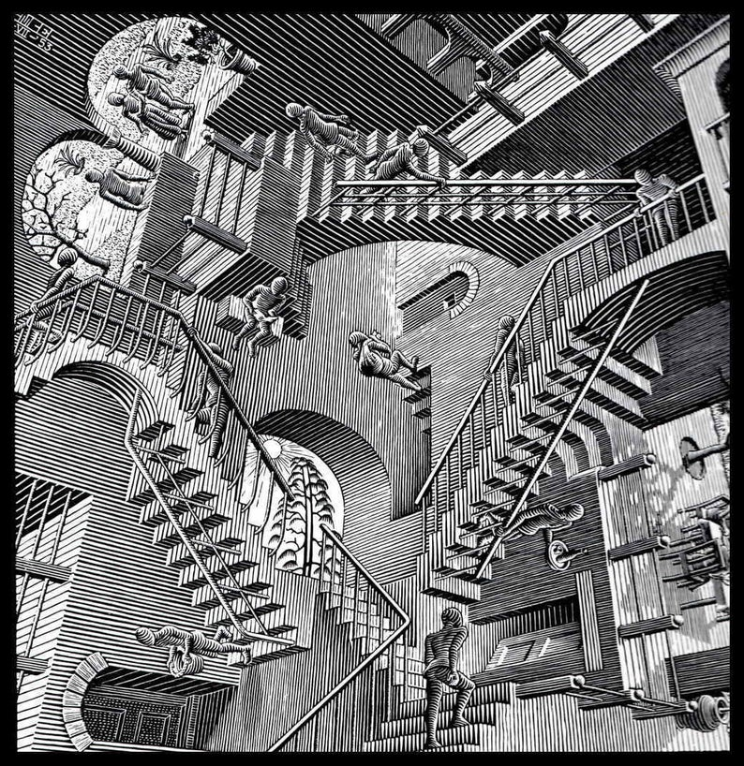
Are you ruled by the Expediency of the Moment?
Mix a few Scrum ceremonies with a Kanban board, or
Aligning the Ceremonies and practices of Scrum with Kanban, or
Are you just confused!
Notes:
Are you mixing them like some kind of IT Methodology Buffet, or
Are you augmenting one with the other, or
Are you just confused

Slide 6
Complimentary but not Compatible
Aren’t They Both Just Agile?
Scrum
Lean Kanban
Light management framework
Short fixed-length sprints
Light schedule determined by Scrum ceremonies
Unit of Work described by a User Story
Focus on Team Dynamics
Quality defined by User Story Acceptance Criteria
Methodology agnostic
A Continuous flow of work
Visualization of work “Pulled” through a queue
Units of work (not predefined)
Focus on Team Dynamics
Focus on Quality & elimination of wastes
Notes:
Lean Kanban is not Scrum
Lean Kanban is based on Just-In-Time, Lean, Kanban & Kaizen.
Scrum focuses on predefined Ceremonies, Sprint length and estimating using Story Points
Both Frameworks have similar origins with Edwards Deming
The PDSA Cycle (Plan-Do-Study-Act)

Slide 7
Scrum Problems
To Scrum or Not to Scrum?
Monster User Stories eating your Scrum board
Constantly resetting Sprint Start/Stop dates
Development must stop three days before Sprint ends to finish testing
Team members pulling multiple User Stories simultaneously
Notes:
Do you need to change your framework to fix these problem?
These issues are all queuing problems
Maybe if you lean the Kanban way, it can help your team stay focused?

Slide 8
Just Go With the Flow Baby!
You Lost that Scrummy feeling
Teams fixate on ceremonies and not process efficiencies
Sprint become schedules, not a rhythm of work helping to accomplish Sprint goals
Release dates dominate the Sprint cadence
The Retrospective becomes an ineffective change feedback loop
Notes:
Scrum teams can lose their way.
These issues can be resolved using Scrum but it goes deeper than that.
These are behavioral issues.
Lean Kanban can help re-adjust less than optimal habits of Scrum teams
What advantages does a Lean Kanban philosophy offer?
With that in mind let’s start with Scrum and add a shot of Lean Kanban

Slide 9

Foundational Principles
All About Your Focus!
Process Controls – Manage Workflows
Team dynamics – self-organizing and collaborative
Useful work – Customer focused, value-based and prioritized
Philosophy of continuous improvements
Make all policies explicit
Metrics
Shippable Products
Notes:
But that’s all Scrum too!
Let’s use these categories for foundational Principles for our evaluation

Slide 10
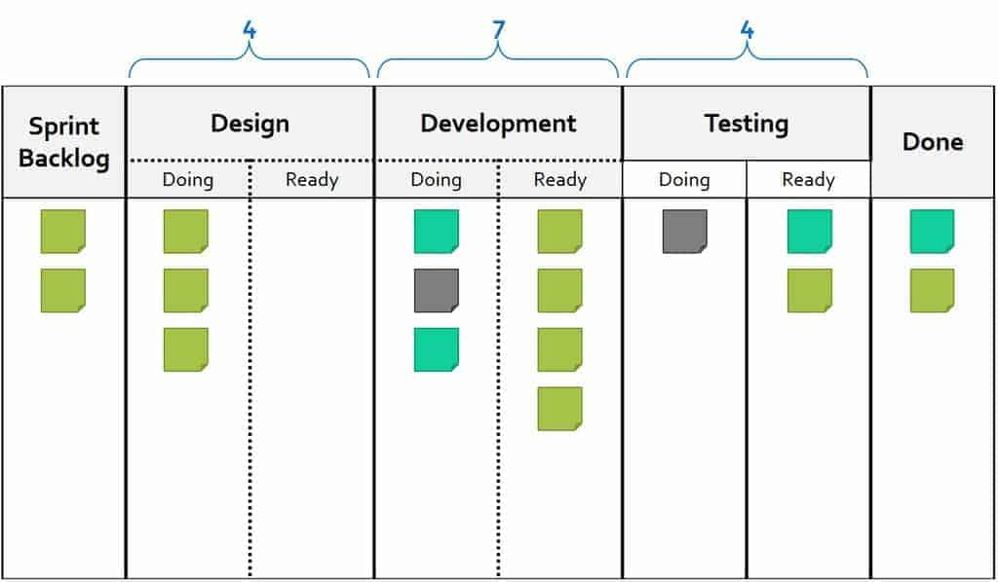
Start your Blending - Whip it Good
1) Process Controls – Manage Workflows
Replace the Scrum board with a Kanban board
Add WIP Limits to the Kanban board
Modify the WIP limits to control the flow of work
Notes:
I hear you Cry – Our ALM tool forces us to use a Kanban board
When you set up your Kanban board modify it to include Design, Development, and Testing
Set WIP limits and modify them based on your current capacity.
WIP Limits act as a governor to control the flow of work
When you see build-up of User Stories in a column it’s unprocessed inventory
This is a form of Waste
The behavior being modified is the tendency of teams to take on too much work simultaneously
Limiting the number of pending requests makes the process more sensitive and reveals inefficiencies

Slide 11
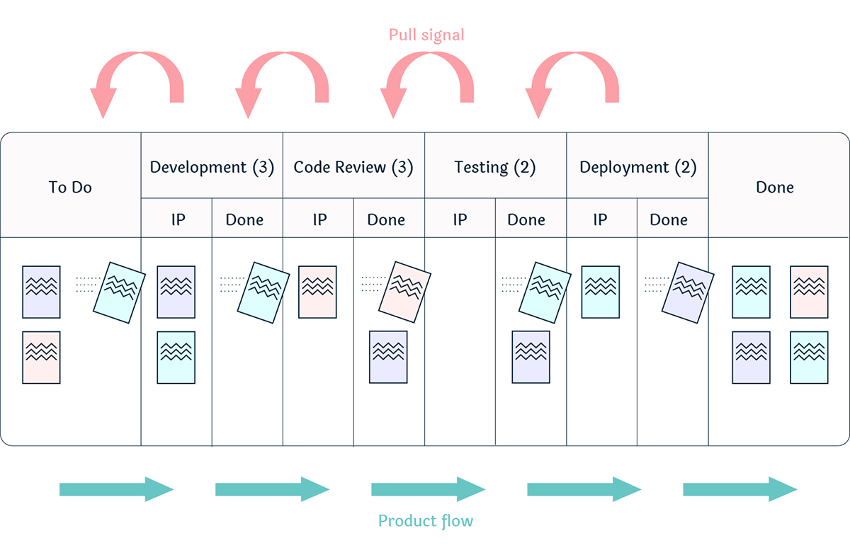
Do you feel triggered yet?
Create a Pull System
Each activity has a corresponding Done column
Finished work is moved to it’s Done column
Creates a signal that work’s available to be pulled to the next activity
Creates a “true” Kanban board with message cards that trigger replenishment

Slide 12

It’s all about the Flow Baby!
Agile Requirements Management
Create a 2nd Kanban board to manage User Stories
Goal - Only enough requirements inventory to satisfy the next immediate “Pull” of developers
Notes:
Now that you have come this far, why not go a bit farther.
Is your PO pulling all nighter’s to get ready for Sprint Planning?
Scrum typically has two backlogs
Sprint Backlog (To Do)
Product Backlog (Everything)
This may lead to shortages or excessive inventory build-up
Your Goal is to create Just enough Requirements to satisfy the immediate “Pull” of the developers

Slide 13
How do you create User Stories?
Are User Stories just a batch of requirements?
Elicitation - BAs gather requirements from Stakeholders and deliver them to the Product Backlog for assessment. Epics are produced.
Elaboration - Epics turned into a list of User Stories, which are fleshed out additional details
Validation - Requirements are verified for completeness, testability, conflicts, and ambiguity
Acceptance - Requirements are accepted by the stakeholders and allocated to releases and iterations
Notes:
Are your User Stories managed like System Specifications - all batched together and presented at Sprint Planning?
Consider Modeling User Stories based on their life-cycle
Four stages of requirements definition of the User Story lifecycle

Slide 14
2) Team dynamics – self-organizing and collaborative
How do Scrum Roles become Lean?
Scrum Master
  Monitors the work queue for blockages, dependencies, and inefficiencies
  Identifies opportunities to eliminate waste
  Ensures there are adequate visual controls in place
Product Owner
  Views User Stories from a life cycle perspective
  Ensures that each developer has just enough inventory to work upon
Developers – pulls only one User Story at a time
Notes:
Lean Kanban doesn’t proscribe a Scrum Master or a Product Owner
Maybe that’s why team leads for Lean Kanban are called Agile Team Facilitator
Consider re-aligning these roles to be more Lean

Slide 15
3) Are You Doing Useful Work?
Maybe you need another Ceremony
Useful Work consumes resources that create value for the customer
Kanban Meeting (Daily Stand-up) – focus on stalled work items, the day ahead & the immediate future
Service Delivery Review (bi-weekly) - How well is the client being served by the team’s output
Replenishment Meeting (weekly) - Select tasks for the backlog
Notes:
Useful Work consumes resources that create value for the customer
Useful work is customer-focused, value-based and prioritized
Consider modifying or adding a few additional Ceremonies

Slide 16
4) Philosophy of Continuous Improvement
More Lean Ceremonies
Retrospectives (bi-weekly) – focus on reducing waste and improving quality
Operations Review (Monthly) – reviews the big picture to determine how to improve efficiencies
Quality Circles – enlists employees in solving problems related to their jobs
Risk Review (Monthly) - Examines factors that put work delivery at risk
Notes:
Expand Sprint closing ceremonies to include:
How can the team improve Quality
How well was the client served by the team's output?
How can operations be improved overall?
What factors put the work delivery at risk?

Slide 17
Eliminate Waste
Have you checked your Muda lately?
Motion – Movements that are more complicated than necessary
Inventory – If it doesn't directly fulfill customer needs, is excessive it should be reduced to a level that directly supports the value stream
Waiting – Includes any idle time caused by the asynchrony of two or more interdependent processes
Overproduction – When production exceeds customer requirements it hides many organizational problems
Transportation – Waste of movement of materials that don't directly correspond to some value-adding process
Over-processing – Putting more work into producing the product than the customer values
Notes:
Muda represents the 7 core types of waste within processes and systems as identified by Toyota’s Lean Kanban
Waste is an activity that consumes resources without creating value for the customer
The elimination of waste is the primary goal of any lean system

Slide 18
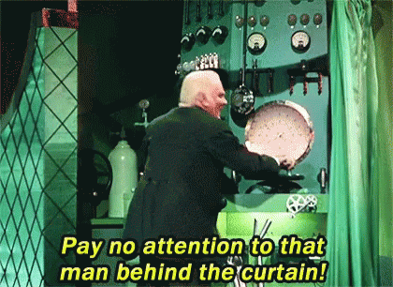
5) Make All Polices Explicit
Let the sun shine in
Embrace an open work Environment
Open up Ceremonies to an extended audience
Publicly display Team Agreements
Publicly display team metrics
Notes:
This is central to both Scrum and Kanban
Embrace an open work environment
Consider publically and visually posting:
Team Charter - Team Agreements, definitions of Ready & Done & shared values
Kanban Board
Team metrics
Embrace ransparency

Slide 19

6) Key Metrics
What are you trying to Measure?
Scrum
  Velocity
  Burn-down/Burn-up Charts
  Story Points
Lean Kanban
  Lead Time
  Cycle Time
  Cumulative Flow
Notes:
Scrum has a focus on the Sprint and Lean Kanban on a continuous flow of work through a queue
Scrum metrics typically focus on aggregate measures of throughput such as: Velocity & Burn-down/Burn-up charts
Many Lean Kanban metrics are specific to the behaviors of individual User Stories, such as: Lead time and Cycle time
The team needs to monitor inefficiencies of inventory as it flows through the work queue
You need to do both sets of metrics

Slide 20
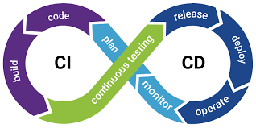
7) Shippable Products
What about a CD/CI Pipeline?
Have Potentially shippable products morphed into batched inventory?
Do you have dependencies based on Release Packages?
Is your board clogged with unshipped inventory
Are you suffering from clogged IT arteries
Consider building a CD/CI pipeline and release User Stories once completed
Notes:
In Scrum, a Potentially Shippable Product Increment means that the Users Stories of each Sprint is potentially shippable
In theory, a Potentially Shippable Product should also refer to the User Stories
In Lean Kanban, one might also have a Release date but a better practice is that each User Story is shippable
Why not implement a CD/CI pipeline

Slide 21


Parting Shots
Flow vs Fixed Schedules
Notes:
One is about continuous flow and the other is about fixed Iteration bound ceremonies
These are mutually exclusive
Your team’s focus will eventually shift from one to the other

Slide 22

Alien-Human Hybrids
How’s that working out for you?
When Blending Consider Foundational Principles
Pick one approach and layer on features from the other
Notes:
Consider starting with Scrum and move closer to Kanban
Blending two complimentary but different philosophies
Stay true to both foundational philosophies
That whole alien-human hybrid thing never really works out well

